Slide 1
Working with Overcontrolled and
Rigid Behavior In Clients:
Insights From Affective Science and
Radically Open Dialectical Behavior Therapy
Jason Luoma, Ph.D., Portland Psychotherapy Clinic, Research, & Training Center
M. Kati Lear, Ph.D., Portland Psychotherapy Clinic, Research, & Training Center
Notes:
Acknowledge using slides from radicallyopen limited, Tom Lynch, Roelie Hempel, Angela Klein
Both introduce ourselves briefly
Kati doing slides 17-28 (18 min), 40-43 (5 min)- goals 1. make it interesting 2. model some therapy technique, 3. discussion/audience interaction

Slide 2
Financial Disclosures
Jason Luoma is CEO of Portland Psychotherapy Clinic, Research, & Training Center, a research and training clinic that provides RO DBT services and ACT services and training.
M. Kati Lear has no relevant financial disclosures
Notes:
[[Jason takes over]]
Test out chat. What are you currently wearing on your feet?
[[POLL: How much do you know about RO DBT]]

Slide 3
Goals of this workshop
Introduce you to the concept of overcontrol
Show you how theory about overcontrol leads to novel interventions that are not obviously predicted by ACT
Demonstrate some of these strategies
Give you an overview of how overcontrol is treated from the perspective of radically open dialectical behaviour therapy (RO DBT)
Notes:
A key goal here is to help you see what the theory behind RO DBT and how some findings from affective science might guide what you would do differently with overcontrolled individuals

Slide 4
How did our ancient ancestors survive without claws, horns or being thick-skinned?
Maybe smart phones?
Notes:
*Key point is to smuggle RO principles – humour
[Have you ever thought about this? Hmmmmmmm…]
Caveman voice/antics: “Maybe smart phones?”

Slide 5
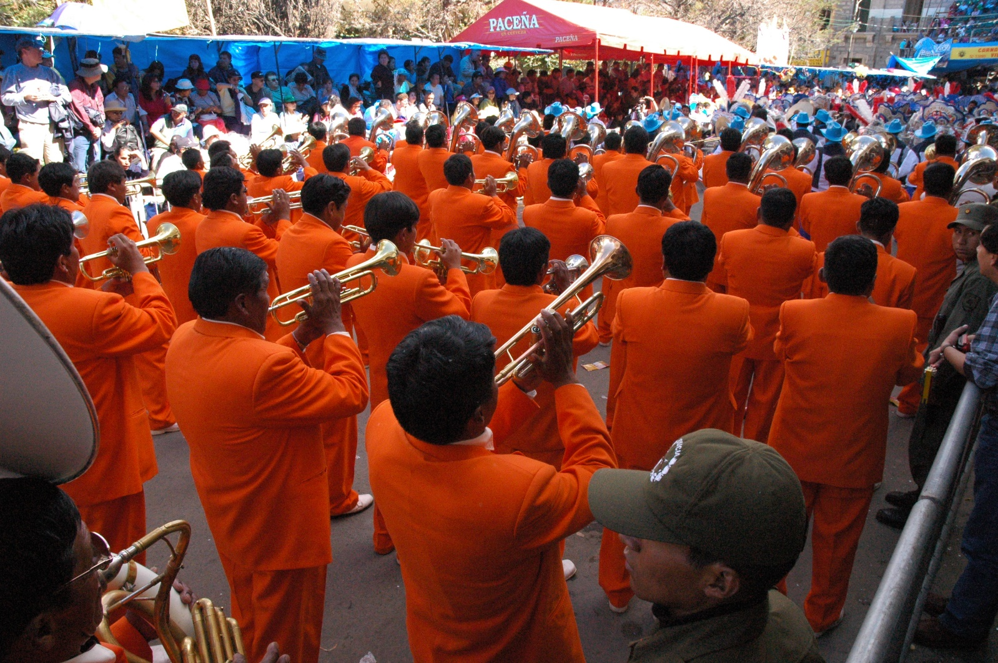
We are tribal creatures
Notes:
At least one primary reasons why we are so successful as a species is that we learned to cooperate at a scale unprecedented in other species. And language facilitates our ability to cooperate and solve problems. We are able to bond with people outside our immediate family and cooperate with people we don’t even know. We can work together and are much more effective when together than we are when we are alone.

Slide 6
We are a tribal species
We evolved means to
override older ‘selfish’ tendencies
linked to the survival of the individual
for the survival of the tribe
Notes:
At a very basic level, we are a tribal species. For probably the last 3 million years, humans and our closest ancestors evolved in small bands of probably 30-50 individuals. We are uniquely adapted to that context.

Slide 7
A key capacity that enabled cooperation: self-control
Self-control = the ability to inhibit emotional urges, impulses, and behaviors in order to pursue long-term goals
Self-control capacities enabled a person to not immediately consume valuable resources and instead save for a ‘rainy day’
PLUS
not acting on every impulse allowed us to work together in groups without the fear of being immediately attacked if we stepped on someone’s toe
Notes:
One of the most important capacities we evolved is self-control.
From this perspective, much of what we teach in ACT can be seen as a form of self-control. much of what we teach in act is about teaching self control. We help people learn how to be better at not responding to urges and action tendencies that result in short term gains and that interfere with values and longer term goals. This points to one possible pitfall for ACT with these individuals. It’s possible that training in acceptance can actually further reinforce tendencies toward overcontrol.

Slide 8
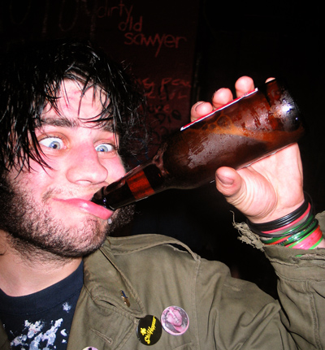
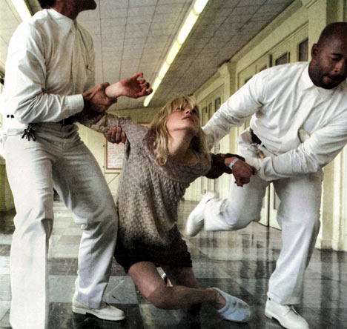
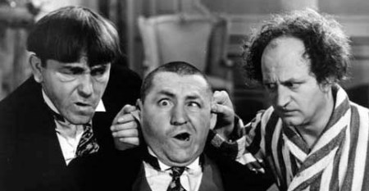
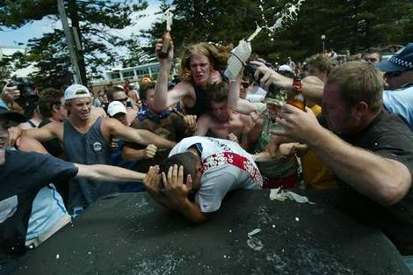
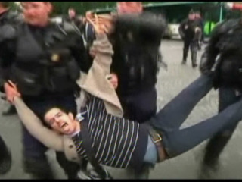
Lack of self-control is eye-catching!
Notes:
Lack of self-control is linked to substance abuse, criminal activities, domestic violence, financial difficulties, teen pregnancy, smoking, obesity—and more!
-But what if you don’t have good self-control? If you lack self-control, you’re going to have problems. For instance,
-[problems – on the slide]
-BPD is quintessential example of disorder of undercontrol

Slide 9
Overcontrol is often not recognised
Overcontrolled people ………
Are not roaming the streets in gangs—they are not the ones having wild parties; they are not the people you see yelling at each other from across the street
They are hyper-detail-focused perfectionists who tend to see ‘mistakes’ everywhere (including in themselves)
And tend to work harder than most to prevent future problems without making a big deal out of it.
Plus, are expert at not appearing different on the outside (in public).
Notes:
Overcontrolled problems are much more subtle and are often not recognized.
They are experts in self control.

Slide 10
Overcontrol is Pro-Social
Desires to be correct, exceed expectations and perform well—is essential for tribal success
Valuing rules and fairness is needed in order to resist powerful yet unethical individuals or harmful societal pressures
Delaying gratification saves valuable resources for less abundant times
Duty, obligation, and self-sacrifice helps societies to flourish and ensures that those in need are cared for
Notes:
So, now we can start seeing how a degree of overcontrol can be prosocial in a variety of ways.
-perfectionism – striving for excellence and setting high performance standards
-Rules and fairness (example: Due to his strong ethics/moral values, an OC patient was the only person in 1970s willing to testify against the Mob in Chicago, because for him, it was the right thing to do)
-Delaying gratification (example: we can store food so we don’t need to hibernate in winter or starve to death during times of scarcity)
-Duty/obligation: doing things not necessarily out of self-centred interests (example: bus breaks down and people are hungry and thirsty, but OC will wait to make sure everyone, including the kids and the elderly in wheelchair get off first BEFORE taking care of themselves)

Slide 11
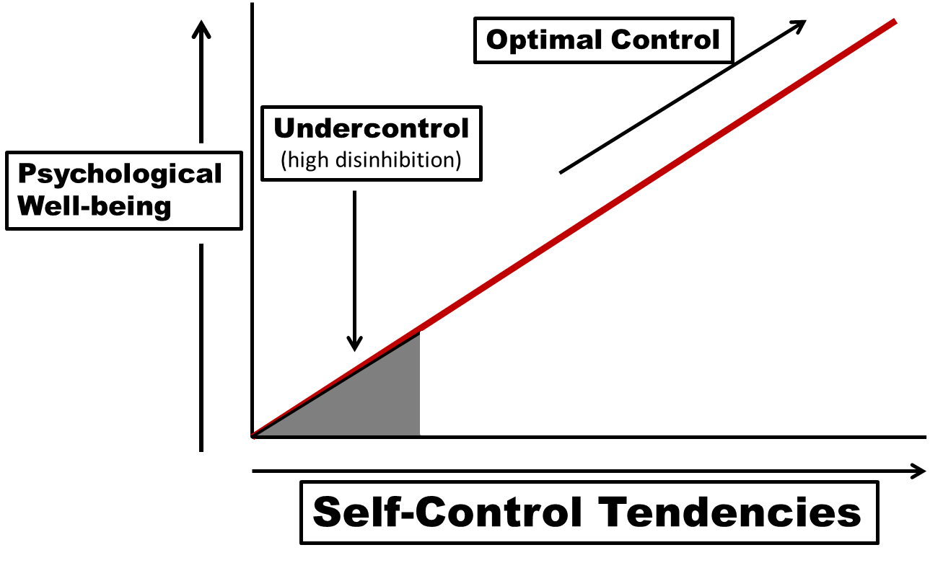
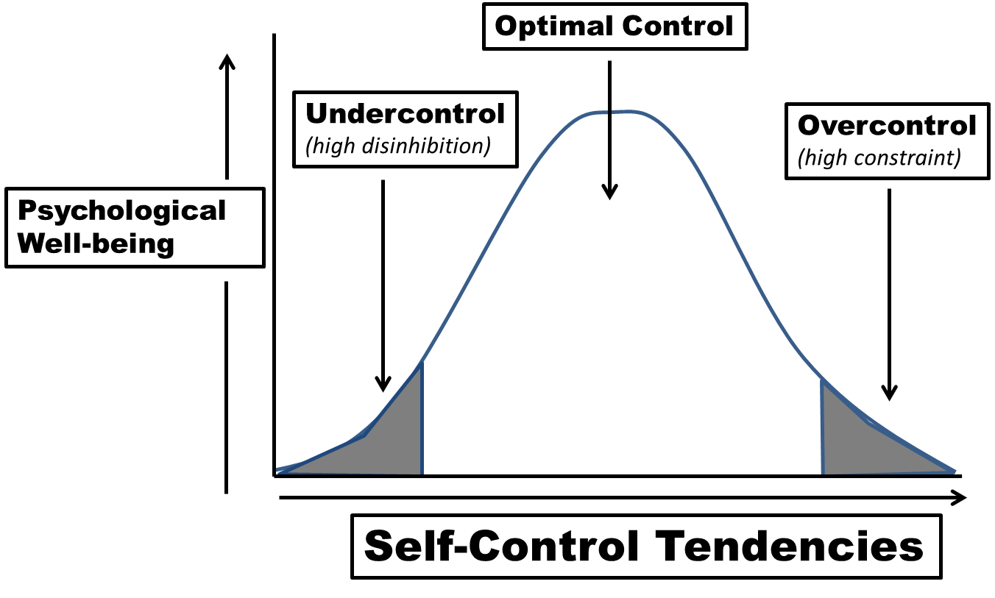
Too much of a good thing: the problem of overcontrol
Existing research tends to see self-control as a linear construct: more is better
However: you can have too much of a ‘good thing’
Notes:
BUT….can you have too much of a good thing?

Slide 12
The Self-Control Dialectic
Overcontrolled (OC)
Undercontrolled (UC)
Emotionally Dysregulated and Impulsive
Borderline PD
Antisocial PD
Narcissistic PD
Histrionic PD
Binge-Purge Eating Disorders
Bipolar Disorder
Conduct Disorders
Externalizing Disorders
Emotionally Constricted and Risk-Averse
Autism Spectrum
Anorexia Nervosa
Obsessive Compulsive PD
Avoidant PD
Paranoid PD
Schizoid PD
Chronic Depression
Treatment Resistant Anxiety-OCD
Internalizing Disorders
Notes:
Clinically, on the UC side we see. . .
Cluster B
And on the OC. . .
Spectrum of biological loading to more environmentally influenced
At the most extreme end of biological loading, autism. . .
Cluster A & C
Of course, this is a broad-brush overview, just to help you start to distinguish.

Slide 13
See next slide
What’s your style?
Notes:
With this, it is not just about clinical disorder. We all have a temperament. And as therapists doing RO and just in general it is important to know which side you lean towards.

Slide 14
Assessing Styles of Coping Word-Pair List
Circle the words or phrases that describe yourself; but only one word in each row.
Tally up the number in each column—the more you have in one column suggests your style.
A | B
Impulsive | Deliberate
Impractical | Practical
Naïve | Worldly
Vulnerable | Aloof
Risky | Prudent
Talkative | Quiet
Disobedient | Dutiful
Fanciful | Realistic
Fickle | Constant
Act without thinking | Think before acting
Animated | Restrained
Changeable Mood | Stable Mood
Haphazard | Orderly
Wasteful | Frugal
Affable | Reserved
Impressionable | Not easily Impressed
Erratic | Predictable
Complaining | Uncomplaining
Reactive | Unreactive
Careless | Fastidious
Playful | Earnest
Notes:
To get a sense of this, this is an example word pairing. The instructions with this are to select a word from each row that best represents you, even if you are a bit of both; the A column represents undercontrol; the B column represents overcontrol.

Slide 15
Assessing Styles of Coping Word-Pair List
Select the word in each row that best describes you.
Tally up the number in each column.
The more you have in one column suggests your style.
UC | OC
Impulsive | Deliberate
Impractical | Practical
Naïve | Worldly
Vulnerable | Aloof
Risky | Prudent
Talkative | Quiet
Disobedient | Dutiful
Fanciful | Realistic
Fickle | Constant
Act without thinking | Think before acting
Animated | Restrained
Changeable Mood | Stable Mood
Notes:
[[[15 min]]
[[POLLL: Did you lean more OC or UC?]]

Slide 16
Overcontrol is a problem
of emotional loneliness
Secondary to
Low Openness
&
Social-Signaling Deficits
Not necessarily
lack of social contact
but
lack of social connectedness
Notes:
[[[KATI starts]]]
So what exactly makes overcontrol problematic, across its various symptom presentations?
Social signalling – non-language signals expressed in social context – ex: body posture, vocal tone/pitch/cadence, facial expression, presence or absence of speech, frequency/ duration of speech
In RO DBT we therefore focus on the social signalling that is interfering with connection, in order to help clients find and join their tribe.

Slide 17
Typical OC Problem Behaviors
Theme | Example Social Signals
Hyper-detail focused and overly cautious | Avoiding feedback and novel situations
Rigid and rule-governed behavior | Compulsive planning & scheduling, eating or exercising same time every day
Inhibited and disingenuous emotional expression | Flat, muted face, smiling or laughing when upset, indirect communication
Aloof and distant style of relating | Not returning calls or texts, avoiding self-disclosure
High social comparisons and envy-bitterness | Blocking expressions of happiness of self or others, gossiping
Emotional Loneliness
Notes:
Research suggests five common themes among OC folks that can contribute to a sense of isolation and emotional loneliness
1). Tendency to be Hyper-detail focused & overly cautious --> avoiding feedback or novel situations – can be overt avoidance or more subtle interpersonal behaviors that function to control interaction and guard against uncomfortable experiences.
2) Rigid & rule-governed behavior: extreme - hyper-scheduled CEO; less extreme – eating same 5 meals each week, strict rules about exercise, moral certitude not sensitive to context – can result being closed off to new or disconfirming information
3) Inhibited and disingenuous expression: flat face or smiling when upset,
Research: flat face - Blank expressions, furrowed brows, or slight frowns are often interpreted as disapproving—regardless of the actual intentions of the sender (e.g., some people frown or furrow their brow when intensely listening). Disingenuous - research on self-concealment, we can sense that and It affects out willingness to trust others when we sense they’re concealing.
4) Aloof & distant style of relating: e.g., not responding to texts, minimal responses, not revealing much about yourself, e.g., asking a lot of questions – research on self-disclosure and liking is pretty clear – we like people more and feel connected when we feel they are genuine and honest with us – e.g., à match plus one
5) High social comparisons & envy-bitterness: target à benign envy (awareness that we want what someone has – useful and can alert us to what's important to us); this differs from the more harmful envy, which is a combination of anger and shame --> motivates urges for secret revenge. We also look at if you even want what the other person has; when you do this you may realize you don’t. Client -SP, e.g., school/intelligence/academic/occupational achievement; - worked as an academic coach in educational settings and went back to school – enjoyed work but felt as though her status wasn't appreciated – envied colleagues in administrative positions for the prestige and fixated on becoming school principle. Ultimately got job as principle and didn't enjoy the work – felt bogged down by the administrative demands and interpersonal management. Left position early and attributed it to personal flaws, failure, lack of ability – through work on clarifying values and building awareness around personal comparisons, realized she never wanted this job in the first place, but pursued it due to unhelpful envy related to status and respect. Pursued alternative education career she's finding engaging and vital
-Example of pushback - Kati: Jason, let's show audience example of problem behavior that OC folks do – would you mind showing them a pushback?
- point: pushbacks block unwanted requests or feedback from others – in this case, it functioned to allow Jason to block a request for help, without having to admit it
R & O – Building openness to novel, unexpected, or disconfirming feedback, learning to tolerate and even welcome uncertainty or spontaneity
Flexible – Build flexibility around compulsive need for structure/order, perfectionism, overreliance on approach coping/compulsive fixing --> learning that there may be several helpful ways of doing things rather than 1 right way
Emotional exp/awareness - practicing building awareness of emotional experience and congruent expression in safe contexts, e.g., expressing concern when feeling it, accurately reporting level of distress vs. Underreporting, smiling when receiving a compliment
Social connectedness & intimacy – building sense of "tribe" through close social connection with at least 1 other person (research shows that benefits of social connection come with only 1 close relationship)

Slide 18
Common OC Behaviors
Themes
Hyper-detail focused and overly cautious
Rigid and rule-governed behavior
Inhibited and disingenuous emotional expression
Aloof and distant style of relating
High social comparisons and envy-bitterness
How RO-DBT Helps:
Foster Receptivity & Openness
Practice Flexible Responding
Build Emotional Expression and Awareness
Enhance Intimacy & Social Connectedness
Emotional Loneliness
Notes:
Research suggests five common themes among OC folks that can contribute to a sense of isolation and emotional loneliness
1). Tendency to be Hyper-detail focused & overly cautious --> avoiding feedback or novel situations – can be overt avoidance or more subtle interpersonal behaviors that function to control interaction and guard against uncomfortable experiences.
-Example of pushback - Kati: Jason, let's show audience example of problem behavior that OC folks do – would you mind showing them a pushback?
- point: pushbacks block unwanted requests or feedback from others – in this case, it functioned to allow Jason to block a request for help, without having to admit it
2) Rigid & rule-governed behavior: extreme - hyper-scheduled CEO; less extreme – eating same 5 meals each week, strict rules about exercise, moral certitude not sensitive to context – can result being closed off to new or disconfirming information
3) Inhibited and disingenuous expression: flat face or smiling when upset,
Research: flat face - Blank expressions, furrowed brows, or slight frowns are often interpreted as disapproving—regardless of the actual intentions of the sender (e.g., some people frown or furrow their brow when intensely listening). Disingenuous - research on self-concealment, we can sense that and It affects out willingness to trust others when we sense they’re concealing.
4) Aloof & distant style of relating: e.g., not responding to texts, minimal responses, not revealing much about yourself, e.g., asking a lot of questions – research on self-disclosure and liking is pretty clear – we like people more and feel connected when we feel they are genuine and honest with us – e.g., à match plus one
5) High social comparisons & envy-bitterness: target à benign envy (awareness that we want what someone has – useful and can alert us to what's important to us); this differs from the more harmful envy, which is a combination of anger and shame --> motivates urges for secret revenge. We also look at if you even want what the other person has; when you do this you may realize you don’t. Client -SP, e.g., school/intelligence/academic/occupational achievement; - worked as an academic coach in educational settings and went back to school – enjoyed work but felt as though her status wasn't appreciated – envied colleagues in administrative positions for the prestige and fixated on becoming school principle. Ultimately got job as principle and didn't enjoy the work – felt bogged down by the administrative demands and interpersonal management. Left position early and attributed it to personal flaws, failure, lack of ability – through work on clarifying values and building awareness around personal comparisons, realized she never wanted this job in the first place, but pursued it due to unhelpful envy related to status and respect. Pursued alternative education career she's finding engaging and vital
R & O – Building openness to novel, unexpected, or disconfirming feedback, learning to tolerate and even welcome uncertainty or spontaneity
Flexible – Build flexibility around compulsive need for structure/order, perfectionism, overreliance on approach coping/compulsive fixing --> learning that there may be several helpful ways of doing things rather than 1 right way
Emotional exp/awareness - practicing building awareness of emotional experience and congruent expression in safe contexts, e.g., expressing concern when feeling it, accurately reporting level of distress vs. Underreporting, smiling when receiving a compliment
Social connectedness & intimacy – building sense of "tribe" through close social connection with at least 1 other person (research shows that benefits of social connection come with only 1 close relationship)

Slide 19
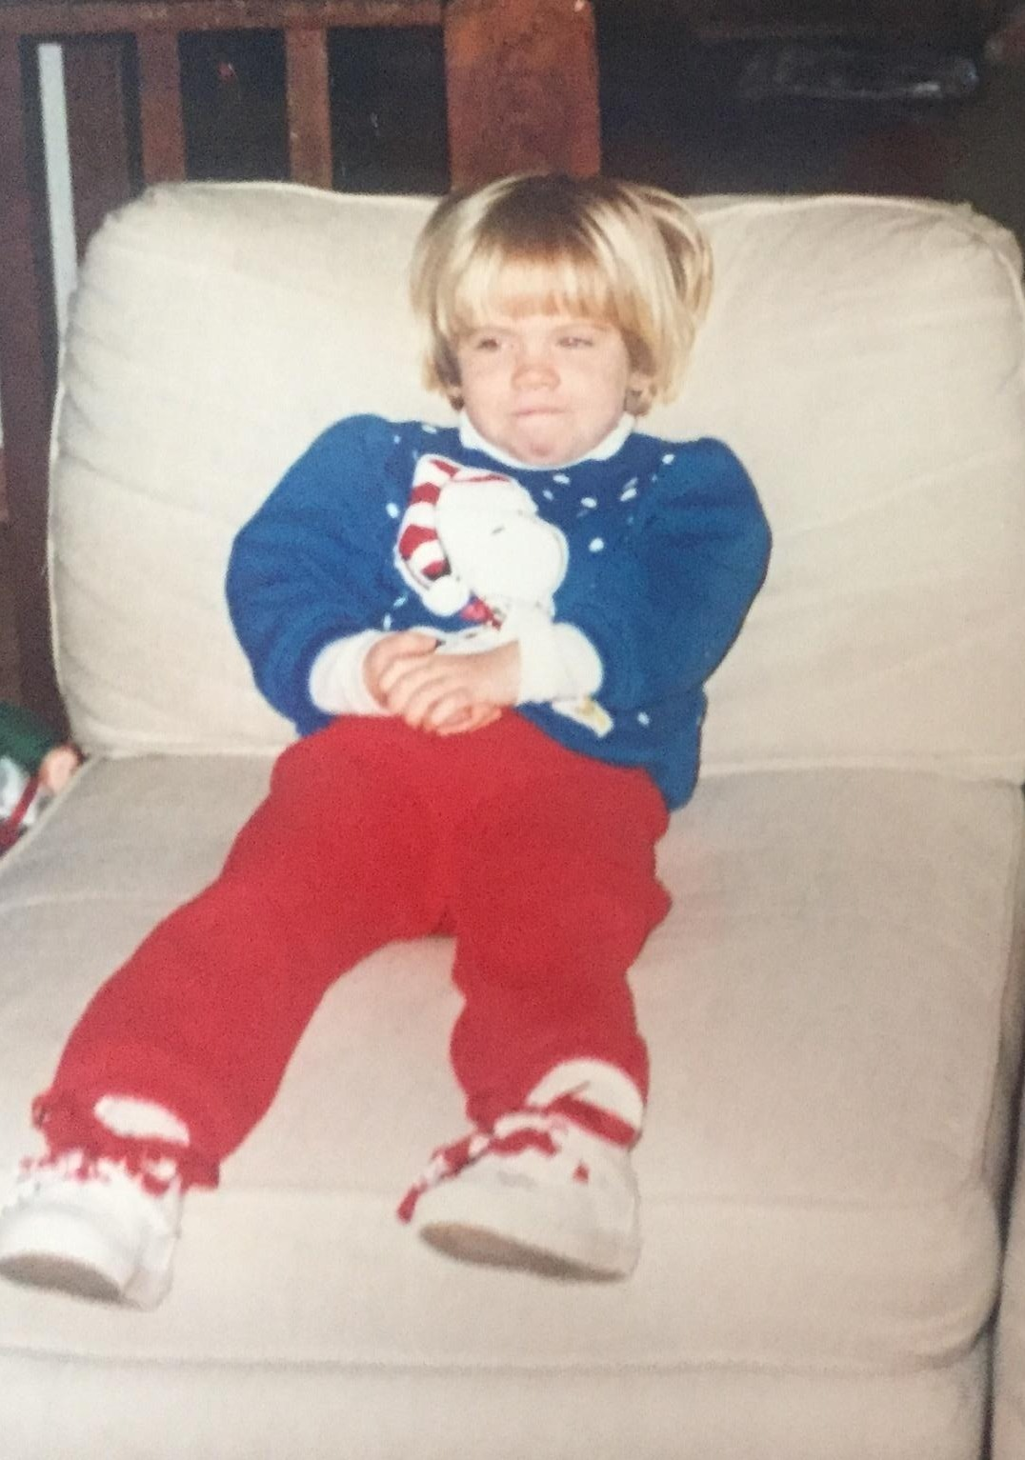
Overcontrol is a combination of biotemperament and environment
UC
OC
Notes:
As I mentioned earlier, it is important to note that overcontrol is. . .
Biotemperament biologically based and expressed very early- can profoundly influence the experiences we seek out and ways we interact with our environment
Matt – 10ish here - Always wore emotions on sleeve – no matter what he was feeling we all knew – learned early on that expressing and sometimes escalating his emotional experiences functioned to meet his needs – class clown – at ease being center of attention – others describe him as bold, funny, brazen, impulsive – social signaling here : open arms, big facial expressions
Me – 5ish – much more on the OC side – characterized as shy, sweet, diligent by others – anxious in novel situations & didn’t readily ask for help or support- tried best to fly under radar and work hard in school– ex. Bully in kindergarten; – social signaling in this picture: averted gaze, collapsed shoulder, clasped hands

Slide 20
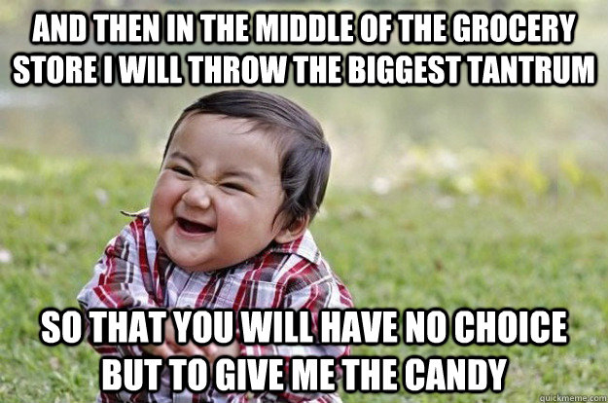
Environmental (e.g., family or cultural) influences: For Undercontrolled…
The Person Learns
“If I escalate my emotional signaling—then good things may happen”
Notes:
Going to be both smaller cultural groups that will shape up over/undercontrolled behavior (e.g., families, church groups) and larger groups (ethnicity, race, gender, institutions) that may shape individuals to be more over or undercontrol – will shape rates of overcontrol and undercontrol inside groups and also affect how it is displayed
Important to acknowledge created by a white guy from America in UK.... who created for and by – this is limited in scope and brings in bias from this perspective
Theory – also aspects of this theory should be universal – part of being human – emerged out of tendency of what our species is like – mix of cultural, environmental and biological interactions
Affective rsearch – smiles similar in form/function across cultures

Slide 21
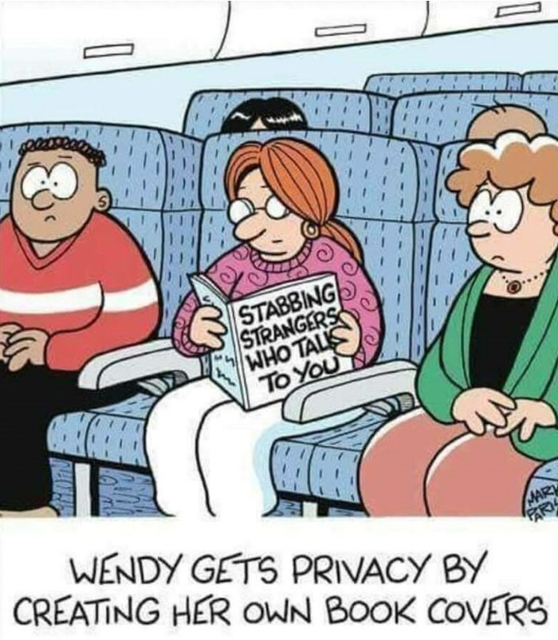
Whereas… for Overcontrolled…
The Person Learns
“If I inhibit my emotional signalling—
then good things
may happen”
Notes:
*RETURN TO NORMAL VOLUME/FLAT FACE*
In contrast, with overcontrol, individuals learn that emotional inhibition is associated with positive outcomes.
Hunting swords and shields
And importantly, for overcontrol, attachment is the problem and avoidance or rejection is the solution.

Slide 22
But…when the Context Calls for Emotional Expression ….
Notes:
Moreover, when the context calls for emotional expression ….
Example: Leaving the office for the weekend to meet up with your friends and it’s time to relax and not be so serious.

Slide 23
...and Emotion is Not Expressed
Notes:
AND emotion is NOT expressed……..

Slide 24
…then signaling matters!
Notes:
That’s when signalling really matters.

Slide 25
Emotions evolved to communicate and facilitate the formation of strong social bonds…
Species survival depended upon signalling cooperation.
Human Facial Expressions are unconditioned stimuli, e.g. we are emotionally reacting to a facial expression at 4 milliseconds (LaFrance, 2013)
We become anxiously aroused when interacting with a non-expressive person AND we prefer not to affiliate with them (Gross, 2002; Butler & Gross., 2003; Barnsley, Hempel, & Lynch, 2011).
Open expression of emotion—even when the emotion is negative—signals trustworthiness and increases social connectedness (Boone & Buck, 2003; Mauss et al., 2011; Feinberg, Willer, & Keltner, 2011)
Notes:
Teaching points:
Cooperation with other people who don’t share our genetics
Our Brains Respond ‘As If’ We are Still Living in Primordial Times—we are evolutionarily hardwired to be ‘hyper-sensitive’ for signs of disapproval—Are we “in” or “out” of the tribe?
The data shows....(point 2). You could mention botox here – reduced expression, people don’t want to hang out with them
It also turns out that ... (point 3). For example, people who blush are more liked – it’s a powerful social signal that shows people that you care about something, e.g. social transgressions, stepping on someone’s toes, or just feeling embarrassed. So BLUSH BLUSH... People are going to like you more!
Facial expressions are unconditioned stimuli that humans respond to, pre-consciously, within milliseconds

Slide 26
The Still Face experiment
Notes:
Show video (2 min 48 sec)
https://www.youtube.com/watch?time_continue=4&v=apzXGEbZht0&feature=emb_logo

Slide 27
Thus...
How we socially-signal strongly impacts our relationships

Slide 28
The key mechanism of change in RO DBT
Notes:
[[Kati stops]]
So, let’s now move to the mechanism of change in RO DBT

Slide 29
Open Expression = Trust = Social Connectedness
Frozen or Masked Inner Feelings
Perceived as Untrustworthy, Stilted, or Inauthentic
Socially Ostracized
Feel Depressed or Anxious
Overcontrol
Flexible-Control
Open Expression & Self-Disclosure
Perceived as Trustworthy & Genuine
Socially
Connected
Feel Safe and Secure
Notes:
[[33 MIN]] In other words, OC individuals act in ways that result in rejection and social ostracism from others
The change that occurs needs to be in their social signaling, not their internal regulation or response to oneself. When their relationships improve, their symptoms fade away without any direct treatment (e.g., anorexia treatment focuses little on eating itself).
This is different than ACT in that the key mechanism of change includes the behavior of other people. This puts social signaling at the heart of the treatment.

Slide 30
The core issue for OC individuals isn’t so much how they cope with their own struggles but how they relate to others
All internally focused work in RO DBT ultimately comes back to how people are social signaling and
whether that signaling brings connects them to or pushes them out of the tribe
Notes:
Some of our clients’ problems are mediated through their social context. Through changing their social signaling then you can improve their relationships and through this, their functioning. This is about co-regulation, not just how they respond to themselves.

Slide 31
Note: Open expression DOES NOT mean…
simply
“Expressing emotions without Awareness or consideration”
On the contrary…. effective emotional expression is always CONTEXT dependent
Notes:
I want to reiterate that successful treatment of OC does NOT mean turning our clients into UCs!

Slide 32
RO DBT teaches there are five neural substrates of emotion
safety, novelty, reward, threat, overwhelming threat
When it comes to OC:
What’s most important is the social-safety system
Notes:
This is all from RO DBT and incorporates work from the polyvagal theory by Stephen Porges.
We teach about all 5 in RO DBT, but today we’re only going to focus on the most important system – the social safety system. For those familiar with compassion focused therapy, this is roughly the same system as what they call the social safeness system

Slide 33
Social Safety System: ventral vagal complex of the parasympathetic nervous system; PNS-VVC
When our social safety system (PNS-VVC) is activated we feel calm, relaxed, and sociable. Our breathing is slow and deep and our heart rate is reduced. We are more likely to want to approach and touch others; and we can effortlessly make eye contact (without feeling self-conscious)
Our social safety system innervates muscles in our body needed to communicate and form close social bonds (Porges, 2007), including:
Voice-box muscles (laryngeal and pharyngeal muscles) allowing a musical tone of voice signaling warmth and friendliness
Middle ear muscles allowing us to hear human speech better
Facial muscles allowing us to signal genuine friendly intentions and smiles e.g., via a genuine smile of pleasure
Diaphragm muscles linked to slow and deep breathing and sighs of contentment
Neck muscles allowing us to direct our gaze
Notes:
Again, emphasizing how this influences connection. . .

Slide 34
Greeting Exercise
Notes:
[[insert slide after this to go to poll]]
Demonstrate the exercise in our pair quickly.

Slide 35
What happened to your voice when didn’t move your eyebrows?
Tone went up
Tone went down
Tone didn’t change
I sounded like Daffy Duck

Slide 36
What did it feel like when you did the exercise without moving your eyebrows?
Awkward
Stilted
Anxious
Confused
Easier
Comfortable
I became enraged

Slide 37
How did having your eyebrows down affect the words you chose?
My language was more terse
I spoke more freely
I found it hard to speak fluidly
It was harder to know what to say
I started blurting out profanities

Slide 38
In which exercise did you feel more trusting or close to the other person?
When I did greeted them normally
When I tried to keep my eyebrows down
What exercise? Was I supposed to be doing situps or something?

Slide 39
Talking Eyebrows
Notes:
Ask: What did you notice? What happened when the comedian lowered his eyebrows? Did his voice tone change? What might explain this?
Teach: Instructors should highlight how his voice tone changed from a musical tone (when he raised his eyebrows) to a flat/monotonic aggressive voice tone (when he lowered his eyebrows). Recall the bidirectional nature of our brain-body: the loss of his musical tone of voice when he lowers his eyebrows likely reflects withdrawal of the comedian’s social safety system (parasympathetic ventral vagal system). The neural substrate linked to social safety controls muscles involved in social engagement and communication, such as listening,facial expressions, and speaking.
Do you notice how his friendliness changes as a function of changing his eyebrows? He seems much more approachable and likable with eyebrows up and less approachable and friendly with eyebrows down.
So, raising your eyebrows can both activate the social safety system and also is part of signaling friendly intentions toward others. OC folks often walk around with perpetual scowls? How do you think this impacts others?

Slide 40
Using social safety to enhance clinical outcomes
RO DBT teaches OC clients how to activate their social-safety system and “turn-off” bio-temperamentally heightened defensive arousal
Plus, RO DBT teaches therapists how to activate social safety in both themselves and their clients by deliberately employing gestures, postures, and facial expressions that universally signal openness, non-dominance, and friendly intentions (via mirror neuron activation and micro-mimicry).
So, what are some of the ways this is done?
Notes:
So learning about this, we can help clients turn on their social safety system and turn off their heightened defensive arousal
With this, the goal is not to help them feel better or develop self-compassion
But rather to change their social signaling, to make their interpersonal interactions more fluid and responsive to others
Also, as therapists, we can turn on our own safety system when we become defensively aroused and by signaling safety, we cultivate a sense of safety in clients through mirroring.

Slide 41
When Tension is Present… Use the Big3 + 1!
Slow The Pace and Chill-Out
Step 1: take a deep breath,
Step 2: raise your eyebrows,
Step 3: engage a warm closed-mouth smile; and
(+1): lean back in your chair (if you are sitting)
Notes:
Talk about how RO DBT teaches therapists to respond to an alliance rupture not by leaning in and acting concerned, but instead by leaning back, raising the eyebrows and adopting an easygoing stance
Ad lib about alliance ruptures in RO DBT and how they are responded to

Slide 42
The Big Three+1
Let's Practice

Slide 43
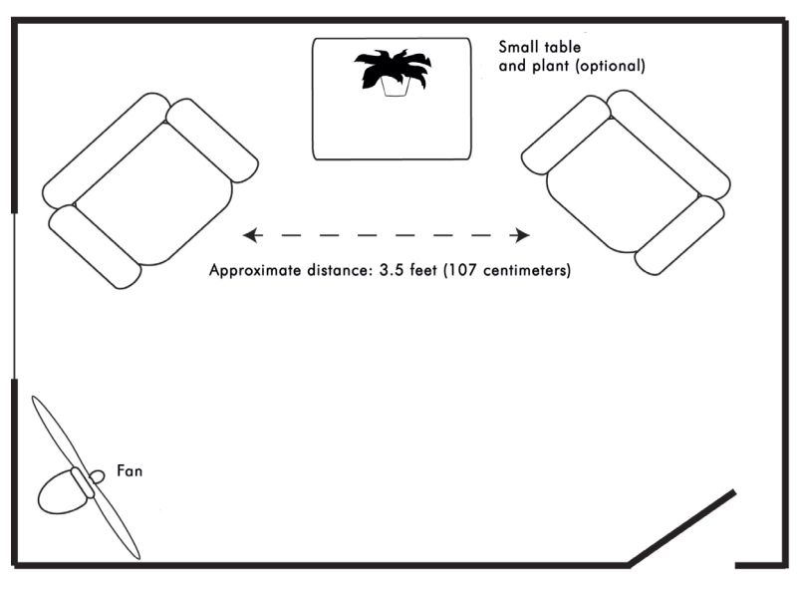
Additional strategies
Room layout and temperature
Taking a drink
Loving kindness meditation
Notes:
Give example of how LKM mediation is done in RO DBT through this insight

Slide 44
Let’s do another exercise!
Notes:
[Kati starts – does slides 40-43]]
Stop screen share before you do exercise: Do participation without planning exercise – Sailing exercise
"Okay everyone – do what I do! WOW, WE'RE SAILORS OF THE SEVEN SEAS! SEE HOW THE BOAT ROACKS AND SWAYS............WHOA... THIS ONE'S REALLY BIG! WHHH! LOOK OUT – IT'S GOING THE OTHER WAY!....and back again....WOAHHH WE. ARE. NOT. IN. CONTROL! And that's okay! We're not in control and that's okay...WHHHHHEEEEEEEEE. Hahahahahah!" ****Clap hands and congratuate everyone****
[[poll]]
Why do you think we did that?

Slide 45
Why do you think we did that?
Notes:
How does an exercise like that relate to overcontrol?
RO therapists enjoy making others uncomfortable
OC folks need to learn to chill out
To overcome overlearned inhibitory barriers
Go give OC folks a visceral experience of being part of a tribe
To provide an experience of passionate participation

Slide 46
Chilling-Out is Therapeutic When Treating OC

Slide 47
Participation without planning
Helps OC folks overcome self-conscious self-monitoring and concerns about tribal status
Gives class members an experience of how uninhibitedly participating is a powerful social signal and creates a sense of tribe
Gives practice in passionate participation - OC clients often need to learn how to be more emotionally-driven, at least in some contexts.
How this relates to ACT:
They need to learn how to chill out, relax, have fun, and party, not calmly accept their emotions and move on.
Notes:
First bullet point – getting folks on the dance floor rather than hanging on the perimeter
[[Kati ends]]
Note that there are a few rules that guide how to do these in RODBT:
Should be unannounced
30-60 seconds
Usually not discussed afterwards
Lots of guidelines on how to work with nonparticipation

Slide 48
So, what is
radical openness?
Notes:
[[59]]

Slide 49
RO DBT considers…
Openness
a
Powerful Social-Signal
Notes:
Who in here likes know it alls?

Slide 50
RO—Developing a passion for going opposite to where you are
Radical openness is more than awareness—it is actively seeking the things one wants to avoid or may find uncomfortable in order to learn.
It involves purposeful self-enquiry and cultivating a willingness to be “wrong” with an intention to change if needed.
Notes:
Radical openness is both a social signal that enhances relationships, but also something you do with yourself, it’s an openness to new information in order to learn.

Slide 51
What is Self-Enquiry?
A mindful way of engaging with emotion and thought in order to learn from it
A practice of asking yourself good questions in order to learn
Different from acceptance and defusion in the goal is to learn something about yourself by inquiring into your perceptual biases
For an outline of the basics of self-enquiry, go to: https://bit.ly/31ygQew
Notes:
Different from ACT and traditional mindfulness where we do not engage directly with the content of our thoughts or emotion. Not just allowing our emotions and thoughts to pass through, but rather engaging actively with them to see what they have to tell us about ourselves and our biases.
Not really about finding an answer but rather finding the next question.

Slide 52
Self-enquiry begins by locating our “edge”
Or “personal unknown”

Slide 53
So...what is an Edge?
Our ‘Edge’ almost always pertains to actions, thoughts, feelings, images, or sensations associated with something we want to avoid, feel embarrassed about, and/or don’t want to ‘think’ about or admit to.
Importantly, painful emotional reactions are not always “edges”.
Our ‘Edge’ is our shadow—our dark side.

Slide 54
Let’s see if we can locate an edge! Whoohoo!
Write down the very first thing that comes to mind in response to these questions:
How do I feel about self-doubt?
Is there a part of me that is afraid if I question myself that I will fall apart? What do I fear discovering that I don’t already know?
How open am I to what is happening right now? Is there a part of me that thinks I am wasting my time or already know the answer?
To what extent am I genuinely able to laugh at my own foibles or mistakes in a kindhearted way? How often do I show this side of me to others? What is it that I might need to learn?
If you noticed any energy or tension in your body in response to any of the above, you might do some further self-enquiry on those questions.
Notes:
Can you type into the text box, would you like to have more or less self-doubt?
RO serves to foster a sense of healthy self-doubt

Slide 55
SELF-ENQUIRY— Basic Principles
Self-enquiry means finding a good question that brings you closer to ‘your edge’ (i.e., your personal unknown)—not a good answer.
Allow yourself time to discover what you might need to learn rather than quickly search for a way to explain things away or regulate.
Practice being suspicious of quick answers or urges to regulate—as they may be masquerading as avoidance.
Keep your self-enquiry practices short (e.g., 5 minutes in duration).
Short and frequent (e.g., daily) practices—using the same question or a new question that had emerged from the previous day are usually more effective.
Longer practices can sometimes be secretly motived by desires to find an answer or a solution.
Practice frequently and keep a record of your observations in your self-enquiry journal. Notice how your questions and practice evolve over time.
Notes:
Refer to Jason’s blog on the RO website
When you get an answer at some point, that will be your new world view

Slide 56
Self-enquiry practice is best done in the presence of a fellow practitioner who is willing to reflect back our blind spots
A process known as “Outing Oneself”
Notes:
But it’s not the only way!

Slide 57
Two-minute silent Self-Enquiry Practice + Homework Assignment
Ask yourself silently...
What am I most closed about that might occur at this conference?
What am I most resistant to learning or doing at this conference? What might that say about what I need to learn?
What is it that I don’t want to admit to myself (or others)?
What areas in my life do I feel secret pride about?
What have caring others suggested in the past that I might need to change but have resisted?
To what extent am I resisting or pretending to engage in this exercise? What might this tell me about myself, my openness, or my willingness to examine my personal reactions?
Begin a self-enquiry journal and record what emerges from your practice (over the next week)

Slide 58
RO DBT Evidence Base, Treatment Delivery, & Structure
Notes:
[[Jason takes over]]

Slide 59
Evidence base
Three Randomized Controlled Trials for Refractory Depression & Overcontrolled Personality disorders (n=34, n=35, and n=250)
Three open-trials (pre-post) for adults and adolescents with Anorexia Nervosa (n=9, n=47, n=101)
One Non-Randomized Controlled Trial for chronic overcontrolled personality (n=117)
Notes:
[[81]]

Slide 60
Large effect size RO DBT versus Treatment as usual
RO-DBT
Other treatments for chronic and non-chronic depression
Notes:
Here is a graph showing effect sizes found in a range of studies that compared end of treatment effects for patients with chronic depression.
We included the CoBAlt study separately because it is most comparable to RefraMED, and we show effect sizes found in meta-analyses of a variety or treatments.
PRESS
As you can see, the effect size found for RO DBT is most comparable to effect sizes found for treatments for non-chronic depression, and is even slightly better!

Slide 61
Modes for Outpatient RO DBT (~30 weeks)
1. Outpatient Individual Session: 1 hour per week
2. Outpatient Skills Training Class: 2.5 hours per week (with 15 minute break)
3. Telephone Consultation: as needed (but rarely used by most OC patients)
4. Therapists’ Consultation Meeting (optional but recommended): practicing radical openness ourselves
Notes:
Now, we are going to be discussing the structure of outpatient RO treatment
RO is being used in a variety of settings - outpatient, inpatient, day treatment, adults, adolescents, skills only etc.
(teaching note)
Read the slide

Slide 62
RO-DBT Individual Treatment Target Hierarchy
Life
Threatening Behaviors
Suicide ideation/behaviors
Self injury
Therapeutic Alliance-Ruptures
Patient feels misunderstood or perceives therapy as not relevant to their problems
Patient not engaged
Changes in the movement, speed, and flow of in-session behavior
OC Behavioral Themes
Inhibited Emotional Expressions
Overly-Cautious and Hyper-Vigilant
Rigid and Rule-Governed Behavior
Aloof and Distant Relationships
Envy and Bitterness
Notes:
In terms of life threatening behaviors, we have developed an RO-specific protocol used to assess life threatening problems in OC, as these need to be dealt with in a manner different than with UC clients.
Self-injury and suicide does not occur only in BPD. Self-injury occurs frequently in the OC population; the major difference being the planned/deliberate nature of the behavior (can give examples of planning cutting, etc – may want to state something about emotional leakage). For more on non-UC NSSI, see work by Matthew Nock and Ed Selby…
Note that for AN clients, the RO therapist is NOT in charge of medical management (so food/weight/hospitalization not primary focus of treatment) and not eating is NOT seen as life threatening behavior unless the person who is in charge of medical management deems it to be so.

Slide 63
RO DBT Skills
Radical Openness Skills [circle each day of the week you practiced a particular skill] | Handout
Flexible-Mind DEF(initely): Three steps for Radically Open Living | 1.B
The Big Three + 1: Activating Social Safety | 3.1
Practiced Loving-Kindness Meditation: Maximizing Social Safety | 4.1
Flexible-Mind VARIEs: Engaging in Novel Behavior | 5.1
Flexible-Mind SAGE skills: Dealing with Shame, Embarrassment, and feeling Rejected or Excluded | 8.A
Flexible-Mind is DEEP: Using Values to Guide Social-Signaling | 10.2
Practiced Being Kind to Fixed-Mind | 11.2
Practiced Learning from Fatalistic-Mind | 11.3
Practiced Going Opposite to Fatalistic-Mind | 11.B
Practiced the Awareness Continuum | 12.1
Mindfulness What Skills: Observe | 12.2
Mindfulness What Skills: Describe | 12.2
Mindfulness What Skills: Participate without Planning | 12.2
Mindfulness How Skill: Self-Enquiry | 13.1
Mindfulness How Skill: Awareness of Harsh Judgments | 14.1
Mindfulness How Skill: One-Mindful Awareness | 14.1
Mindfulness How Skill: Effectively and with Humility | 14.1
Practiced Identifying Push-Backs & Don’t-Hurt-Me Responses | 16.1
Flexible-Mind REVEALs: Responding with Interpersonal Integrity | 16.3
Flexible-Mind ROCKs-ON: Enhancing Interpersonal Kindness | 17.1
Practiced Kindness First and Foremost | 17.2
Practiced Open-Minded Assertiveness: PROVE skills | 18.A
Flexible-Mind Validates: Signaling Social Inclusion | 19.A
Flexible-Mind ALLOWs: Enhancing Social Connectedness | 21.1
Practiced MATCH +1: Establishing Intimate Relationships | 21.2
Flexible-Mind ADOPTS: Being Open to Feedback | 22.1
Flexible-Mind DARES: Managing Unhelpful Envy | 27.A
Flexible-Mind is LIGHT: Changing Bitterness | 28.A
Flexible-Mind has HEART: Learning How to Forgive | 29.A

Slide 64
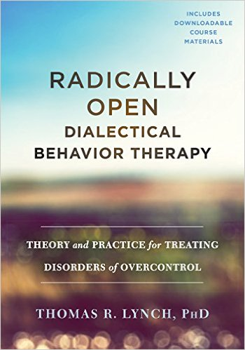
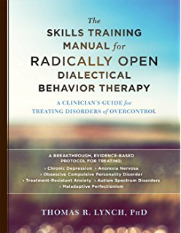
Thank you!
For more information on RO DBT, visit www.radicallyopen.net

Slide 65
END OF TALK

Slide 66
Detailled RO DBT Research Slides

Slide 67
Three Randomized Controlled Trials for Refractory Depression & Overcontrolled Personality disorders
Lynch et al., 2003, International Journal of Geriatric Psychiatry (N = 34) | Results: at the end of treatment, 71% of RODBT patients were in remission, in contrast to 46% of controls (antidepressant medication). This went up to 75% remission in RO DBT compared to 31% among controls at 6-month follow-up – a significant difference.
Lynch et al., 2007, American Journal of Geriatric Psychiatry (N = 35); | Results: 71% of RO-DBT recipients were in remission post-treatment compared with 50% of controls (antidepressant medication + psychiatric care). This trend that was maintained at 3-month follow-up but levelled at 6-month follow-up
Lynch et al., 2015, British Medical Journal-Open; Lynch et al., in press (N = 250) | Results: Only 4% of patients did not meet criteria for a comorbid mental health or personality disorder; 87% of patients reported at least one other mental health disorder; 79% of patients reported at least one personality disorder Main outcome: Hamilton Depression Rating Scale Large effect size post-treatment (d=1.03), RO DBT patients remained less depressed but effects levelled off at 12 and 18 months post-randomization

Slide 68
Large effect size RO DBT versus Treatment as usual
RO-DBT
Other treatments for chronic and non-chronic depression
Notes:
Here is a graph showing effect sizes found in a range of studies that compared end of treatment effects for patients with chronic depression.
We included the CoBAlt study separately because it is most comparable to RefraMED, and we show effect sizes found in meta-analyses of a variety or treatments.
PRESS
As you can see, the effect size found for RO DBT is most comparable to effect sizes found for treatments for non-chronic depression, and is even slightly better!

Slide 69
Three open-trials (pre-post) for adults and adolescents with Anorexia Nervosa
Overall response rate 90%
Lynch et al., 2013, BMC Psychiatry (N = 47); | Significant and large effect size increases in body mass index (BMI) using intent-to-treat analyses (d = 1.71) and for completers (d = 1.91). 35% of the treatment completers were in full remission and 55% partial remission (=90% response rate).
Chen et al., 2014, International Journal of Eating Disorders (N = 9) | Intention-to-treat analyses showed significant increases in weight gain and menses resumption for 62% of the sample at the end of treatment. They found large effect size for increases in BMI, which was sustained at 6 months and 1-year follow-up, and a medium effect size for improvements on Eating Disorder Examination scores (d=0.46), sustained at 6-months (d=0.45), with small effect size at 12 months (d=0.34)
Simic et al., 2017, 2018, the Behavior Therapist (N=56) | Correlational study: Social connectedness was significantly positively related to high anticipatory reward; and negatively related to high threat, ambivalence over emotional expression, inflexibility, risk aversion, perfectionism, and workaholism (see graph) Open Trial: At the end of treatment: Significant improvements in social connectedness (d=0.60) and consummation of pleasure (d=0.53) Significant decreases in withdrawal (d=0.69), perfectionism (d=0.44) and negative temperament (d=0.34)

Slide 70
One Non-Randomized Controlled Trial for chronic overcontrolled personality dysfunction
Keogh et al., 2015, Journal of Practice Innovations (N = 117)
Results:
Post-Treatment, RO-DBT Skills Alone compared to TAU post-treatment demonstrated significantly greater improvements in:
Global severity of psychological symptoms (large effect)
Social safeness (medium effect)
Rigid needs for structure (small effect)
Effective use of coping skills (medium to large effects DBT-WCCL scales)
At 3-month follow-up, the RO-DBT Skills Alone group showed significantly greater improvements in:
Global severity of psychological symptoms (large effect)
Rigid needs for structure (large effect)
Effective use of coping skills (large effects for both DBT-WCCL scales)
Large
Medium
Small
Notes:
PRESS
Keogh et al. compared data from 58 patients who attended RO DBT Skills classes with data from 59 patients who were on the waiting list for this treatment. In addition, patients who had completed the RO skills classes were followed up 3 months later.
PRESS
Skills classes were offered twice a week and lasted 3 hours, and this was offered over a period of 9 weeks in a closed group format.
PRESS
6 patients dropped out of the RO Skills Class.
PRESS
Post-treatment, when comparing the RO group with the Treatment as Usual Wait-List group, patients who had attended RO skills classes had significantly greater improvements in global severity of psychological symptoms, social safeness, rigid needs for structure, and effective use of coping skills. The effect sizes varied from small (for social safeness) to medium and large for all other measures, as shown in the graph.
PRESS
When comparing the scores of the RO Skills class completers from baseline to 3 months follow-up, patients still reported significant improvements in global severity of psychological symptoms, rigid needs for structure, and effective use of coping skills. All of these findings had large effect sizes. Only social safeness was no longer significantly different., although scores had increased post treatment and at follow-up compared to baseline.
NOTES:
Norms for partial eta-squared: small = 0.01; medium = 0.06; large = 0.14.

Slide 71
RCT 1: RODBT-E for Chronic Depression & Overcontrolled Personality Disorders (Lynch et al., 2003)
Thirty-four chronically depressed individuals of 60 years or older (HAMD > 18 or BDI > 19) were randomized to
MED: Medication (antidepressants) alone (n=17). Percentage with at least one PD: 18%
RO DBT-Early + MED: Two presentations of 14 weeks of RO DBT-E & telephone contact plus antidepressants (n=17). Percentage with at least one PD: 45%
Results: at the end of treatment, 71% of RODBT patients were in remission, in contrast to 46% of controls
This went up to 75% remission in RO DBT compared to 31% among controls at 6-month follow-up – a significant difference.
Only patients in the RO DBT group reported changes in personality style associated with fears of being liked by others and increases in adaptive coping – both maintained at 6 month follow-up
Notes:
READ SLIDE

Slide 72
RCT2: RODBT-E2 for Chronic Depression & Overcontrolled Personality Disorders (Lynch et al., 2007)
Thirty-seven treatment resistant depressed patients (HAMD > 18) over 55 years old with comorbid PD were randomized to
MED + CARE: antidepressant plus general psychiatric care (n=14)
RODBT-E2: 24 weeks of RODBT-E2 (weekly 2-hour skills class and 1-hour individual) plus antidepressant medication (n=21)
Results: 71% of RO-DBT recipients were in remission post-treatment compared with 50% of controls
This trend that was maintained at 3-month follow-up but levelled at 6-month follow-up,
RO DBT participants demonstrated significant improvements in personality dysfunction (interpersonal aggression, interpersonal sensitivity) compared to the control group, and these advantages were maintained at 6-month follow-up
Notes:
READ SLIDE

Slide 73
RCT 3: REFRAMED: multi-site randomized controlled trial (Lynch et al., 2015; 2018)
Funded by the National Institute for Health Research – Efficacy & Mechanisms Evaluations (NIHR-EME)
Aim: Test efficacy and mechanisms of RO DBT versus Treatment as Usual (TAU) for patients with treatment resistant depression
Setting: Three treatment sites in UK: Dorset, Hampshire, North Wales
Sample: 250 treatment-resistant depressed patients (HAMD > 14)
Includes the most difficult-to-treat clients (suicidal, chronic, PD, older).
Treatments: patients were randomized to
RO DBT (weekly individual therapy + skills class for 7 months) : n=162
TAU (any treatment patients were offered through the National Health Service): n=88
More patients were allocated to the RO DBT condition in order to study mechanisms of change
N=250
RO DBT
N=162
TAU
N=88
Assessments at baseline, 7 months (post-treatment), and 12 and 18 months following randomization
Notes:
Recently the RefraMED study has been carried out and completed. This was a multi-site randomised controlled trial that aimed to test the efficacy, mechanisms and cost-effectiveness of RO DBT versus treatment as Usual for patients with treatment resistant depression.
RO DBT consisted of 7 months of weekly one-hour individual treatment and 2.5-hour skills classes, while treatment as usual consisted of any type of treatments patients could access either via the UK’s National Health Service or privately. This included both antidepressant medication as well as psychotherapy.
PRESS
A total of 250 patients were assessed and subsequently randomised. As you can see more patients were allocated to RO DBT than the Control group; this was done because we also wanted to investigate the underlying mechanisms of the treatment, and for that we needed a larger number of patients receiving RO DBT.
PRESS
Patients were treated at three different treatment sites throughout the UK, and were assessed at 4 time-points: at baseline, at the end of treatment around month 7, 5 months after the end of treatment at month 12, and finally 1 year after the end of treatment around month 18.
PRESS
22% of participants withdrew or were otherwise lost to follow-up at month 12; the percentages in each group were comparable with 21 in the RO DBT group and 25% in the control group. However, only 4 patients withdrew from treatment, defined as having attended 3 or fewer sessions.

Slide 74
RefraMED Study Co-Morbidity Rates (Lynch et al., 2018)
Of a sample of 250 chronically depressed patients:
Only 4% of patients did not meet criteria for a comorbid mental health or personality disorder
87% of patients reported at least one other mental health disorder
The two most common disorders were
Social phobia (80%)
Specific Phobia (63%)
79% of patients reported at least one personality disorder
The two most common personality disorders (PDs) were
Avoidant PD (54%)
Obsessive-compulsive PD (47%)
Notes:
Our study further confirmed the high comorbidity rates in chronic samples.
PRESS
Only 4% of 250 patients did NOT meet criteria for any additional mental health or personality disorder.
PRESS
Based on the SCID-I interview, 87% of patients reported at least one other mental health disorder, with the two most common ones being social phobia and specific phobia.
PRESS
And based on the SCID-II interview, 79% of patients reported at least one personality disorder. The two most common ones were avoidant PD and obsessive-compulsive PD.

Slide 75
Does RO-DBT work for Refractory Depression?
Effect sizes between group difference
Month 7 | 1.03*
Month 12 | 0.41
Month 18 | 0.32
Notes:
So…. Did RO-DBT work for refractory depression?
PRESS
The short answer is YES it does. In this graph, the red line represented the scores on the Hamilton Rating Scale for Depression for the RO DBT group and the yellow lines represents the scores of the Control group. What can be seen, is that depression scores drop much faster in the RO DBT group than in the Control group, and the difference in scores between the two groups is statistically significant.
PRESS
This difference between the groups had a large effect size of 1.03.
The differences in scores between the groups are not statistically significant at months 12 and 18, although we still find moderate effect sizes for these time points.
Also important to note here is that depression scores remained low during the follow-up phase, suggesting that the treatment has a lasting effect.
Segway: Effect sizes are useful because they allow us to compare the results of different studies with each other.

Slide 76
Large effect size RO DBT versus Treatment as usual
RO-DBT
Other treatments for chronic and non-chronic depression
Notes:
Here is a graph showing effect sizes found in a range of studies that compared end of treatment effects for patients with chronic depression.
We included the CoBAlt study separately because it is most comparable to RefraMED, and we show effect sizes found in meta-analyses of a variety or treatments.
PRESS
As you can see, the effect size found for RO DBT is most comparable to effect sizes found for treatments for non-chronic depression, and is even slightly better!

Slide 77
Open trial 1: RO DBT for Anorexia Nervosa (Lynch et al., 2013)
Overall response rate 90%
Sample: 47 adults diagnosed with Anorexia Nervosa-restrictive type (mean admission BMI = 14.43) received RO DBT inpatient treatment (mean length = 21.7 weeks).
Overall study drop-out = 27% (n = 13)
6% dropped out of RO-DBT (n = 3)
19% declined further weight restoration and left unit against medical advice (n = 9) ; 2% chose to continue weight restoration as outpatient (n = 1)
Results:
Significant and large effect size increases in body mass index (BMI) using intent-to-treat analyses (d = 1.71) and for completers (d = 1.91).
Large effect size improvements in eating-disorder related psychopathology & psychological distress for treatment completers.
Notes:
In 2013 Lynch et al published an open trial comparing before and after scores on a range of measures
PRESS
of 47 adults with anorexia nervosa who had received, on average, 22 weeks of inpatient RO DBT.
PRESS
The overall study drop-out was 27% whereas the RO DBT treatment dropout was only 6%.
PRESS
The study found significant and large effect sizes for increases in body mass index. This was true when looking at the entire sample of everyone who started the treatment regardless of whether or not they finished it, and the effect size was larger if only those patients who had completed the treatment were included in the analysis.
PRESS
This study also found that 35% of the treatment completers were in full remission and 55% partial remission.
PRESS
In other words, the response rate for those who completed treatment was 90%.
PRESS
Finally, the study also looked at improvements in other areas of functioning, and found large effect sizes for increases in eating-disorder related psychopathology and psychological distress for those who had completed the treatment.
For AN in adults, there is no established treatment. Currently CBT and IPT are recommended but the evidence is scarce.
Intention-To-Treat: 20% of entire sample in full remission and 41% in partial remission; Full remission defined as cessation of severe dietary restrictions and BMI > 18.5. Partial remission = at least one of these two criteria
Completers: 35% of completers in full remission and 55% in partial remission (90% response rate)
These rates of remission and weight gain are encouraging because the literature on AN shows that higher BMI during treatment predicts better relapse prevention. These rates of remission are comparable to rates of remission seen in outpatient settings and are noteworthy because they were achieved in amore severe underweight and chronic population.

Slide 78
Open Trial 2: RO DBT for Anorexia Nervosa (Chen et al., 2014)
Sample: 9 adult female AN patients (age range 19-51 years). At baseline:
Average BMI of 18.7
75% met subclinical or full criteria for binge-purge AN
88% had at least one comorbid Axis-I DSM-IV disorder (e.g. depression); 63% had at least one comorbid Axis-II DSM-IV disorder (e.g. obsessive-compulsive PD)
25% reported histories of suicidal or non-suicidal self-injury
Treatment: Standard Individual DBT + 32 weeks Radical Openness Skills classes (mean months of treatment = 8). Treatment dropout = 1 (11%)
Results
Intention-to-treat analyses showed significant increases in weight gain and menses resumption for 62% of the sample at the end of treatment.
Large effect sizes for BMI; medium effect sizes EDE (graph)
Notes:
PRESS
In this study, 9 female adults with AN received DBT plus RO skills. They had an average BMI of 18.7, 75% met criteria for Binge-Purge AN; 88% had at least one comorbid Axis-I DSM-IV disorder (e.g. depression); 63% had at least one comorbid Axis-II DSM-IV disorder (e.g. obsessive-compulsive PD; and 25% reported histories of suicidal or non-suicidal self-injury.
PRESS
The clients received standard DBT plus 32 weeks of RO specific skills classes.
1 patient dropped out.
PRESS
Intention-to-treat analyses showed significant increases in weight gain and menses resumption for 62% of the sample at the end of treatment.
PRESS
In addition, DBT plus RO achieved a large effect size for increases in BMI, which was sustained at 6 months and 1-year follow-up, and a medium effect size for improvements on Eating Disorder Examination scores (d=0.46), sustained at 6-months (d=0.45), with small effect size at 12 months (d=0.34)

Slide 79
Open Trial 3: RO DBT for Adolescent Anorexia Nervosa (South London and Maudsley NHS Foundation Trust; Child and Adolescent Eating Disorder Service)
Feasibility Study (Simic et al., 2016; Astrachan-Fletcher, Giblin, Simic, Gorder, 2018)
Sample: 45 adolescent AN patients
Social connectedness was significantly
positively related to high anticipatory reward; and
negatively related to high threat, ambivalence over emotional expression, inflexibility, risk aversion, perfectionism, and workaholism (see graph)
Social connectedness and reward responsiveness were negatively correlated with all composites of the Eating Disorders Inventory-3, i.e. with more severe eating disorder psychopathology.
Open Trial (Simic et al., 2017; Astrachan-Fletcher, Giblin, Simic, Gorder, 2018)
Sample: 56 adolescent AN patients
Patients received outpatient or day treatment RO DBT
At the end of treatment:
Significant improvements in social connectedness (d=0.60) and consummation of pleasure (d=0.53)
Significant decreases in withdrawal (d=0.69), perfectionism (d=0.44) and negative temperament (d=0.34)
Notes:
PRESS
In their first feasibility study, which included 45 adolescent AN patients, they found that social connectedness, a proposed treatment mechanism, was significantly and positively related to high anticipatory reward, while it was negatively related to high threat sensitivity, ambivalence over emotional expression, inflexibility, risk aversion, perfectionism and workaholism. All of these findings show that their adolescents exhibited the hypothesized traits associated with maladaptive overcontrol.
PRESS
In addition, they found that social connectedness and reward responsiveness were negatively related with more severe eating disorder psychopathology. In other words, adolescents with more severe symptoms experience less social connectedness and less reward responsiveness.
PRESS
In the open trial they subsequently conducted in a sample of 56 AN adolescents who received outpatient RO DBT, they found significant improvements in social connectedness and consummation of pleasure (both medium effect sizes). They also found significant reductions in withdrawal (which had a medium effect size), and small effects for decreases in perfectionism and negative temperament.

Slide 80
Non-Randomised Controlled Trial: RO DBT Skills Only for treatment resistant over-controlled adults (Keogh et al., 2015)
Design: RO-DBT Skills Group Alone (n = 58) compared to Treatment-As-Usual wait-list (n = 59). The RO group was followed-up after 3 months (n=19)
Treatment: RO skills class consisted of twice weekly three-hour classes over a period of nine weeks (group closed; total classes = 18).
Results:
10% (n = 6) drop-out rate for RO-skills group; no significant differences between drop-outs and treatment completers
Post-Treatment, RO-DBT Skills Alone compared to TAU post-treatment demonstrated significantly greater improvements in:
Global severity of psychological symptoms (large effect)
Social safeness (medium effect)
Rigid needs for structure (small effect)
Effective use of coping skills (medium to large effects DBT-WCCL scales)
At 3-month follow-up, the RO-DBT Skills Alone group showed significantly greater improvements in:
Global severity of psychological symptoms (large effect)
Rigid needs for structure (large effect)
Effective use of coping skills (large effects for both DBT-WCCL scales)
Large
Medium
Small
Notes:
PRESS
Keogh et al. compared data from 58 patients who attended RO DBT Skills classes with data from 59 patients who were on the waiting list for this treatment. In addition, patients who had completed the RO skills classes were followed up 3 months later.
PRESS
Skills classes were offered twice a week and lasted 3 hours, and this was offered over a period of 9 weeks in a closed group format.
PRESS
6 patients dropped out of the RO Skills Class.
PRESS
Post-treatment, when comparing the RO group with the Treatment as Usual Wait-List group, patients who had attended RO skills classes had significantly greater improvements in global severity of psychological symptoms, social safeness, rigid needs for structure, and effective use of coping skills. The effect sizes varied from small (for social safeness) to medium and large for all other measures, as shown in the graph.
PRESS
When comparing the scores of the RO Skills class completers from baseline to 3 months follow-up, patients still reported significant improvements in global severity of psychological symptoms, rigid needs for structure, and effective use of coping skills. All of these findings had large effect sizes. Only social safeness was no longer significantly different., although scores had increased post treatment and at follow-up compared to baseline.
NOTES:
Norms for partial eta-squared: small = 0.01; medium = 0.06; large = 0.14.

Slide 81
About me, Angela Klein, Ph.D.
Clinical psychologist in private practice
Ph.D. in clinical psychology, University of Missouri-Columbia, 2009
Centered Ground, San Diego & Carlsbad, North County, since 2014
CBT and DBT treatment, including standard DBT, RO, and DBT-based mindful eating for adolescents, families, and adults
Intensively trained in RO as of January 2015
Author of “Mindful Eating from the Dialectical Perspective: Research and Application” (Routledge, 2016), as well as peer-reviewed eating disorder research
Extensive previous experience developing, implementing, and researching DBT-based approaches across varied levels of care, specializing in eating disorders
Notes:
For those who want more detail, with introductions, I usually have a slide that gives more detail as background to my brief overview. Do we want to maybe include a slide like this for both of us?
[[JL: I don’t usually do this. I’d personally vote we not have these slides in order to shorten the presentation. If you’d rather keep one for you, I’d suggest we keep our intros to 30 seconds or less since there is little time in this workshop, so you won’t have time to read the whole slide.]]
I would give a brief overview, it is just there for folks to reference for more detail if they want it. It seems like we have different views on this, e.g., the later slide with the brain behavioral model detail. I use it in every talk I have given on RO, so it feels strange to not have it. And likewise with not having this slide. But it seems like it would be very unbalanced if only I had a detailed intro slide and you are more of the expert in this conference so I will defer to you.

Slide 82
Self-inquiry practice
Person outing themselves: Tell your partner about an emotional event, without justifying, defending, or rationalizing
Listener to person outing themselves:
After 1-2 minutes, ask: “Are you at your edge?”
If not, then: “What do need to do to get there?”
Then, whether the person has found their edge or not: “What is it that you might need to learn from this situation?” AND/OR “What question might you need to ask yourself in order to learn?”
Every 30 seconds, “Are you still at your edge, or have you regulated?”
If regulated, “Then what question do you need to ask to get back there?”
Notes:
Practice in pairs
Car wash example

